Slide 1



Banking System Simulation
A Java-Based Mini Project
KHUSHI SHRIVASTAV (1BF24CS139)
KOMAL GUPTA (1BF24CS144)
MIMANSA SHARMA (1BF24CS173)
NAINCY (1BF24CS186)
Notes:
1

Slide 2
Project Overview
What Is It?
Purpose
Real-World Application
A simulation replicating real-world banking operations through a web-based interface
Demonstrate core Java concepts and MVC architecture in a practical application
Mimics deposit, withdrawal, and transaction tracking found in actual banking systems
Notes:
2

Slide 3





System Flow
How users interact with the banking simulation from start to finish
User
Initiates session
Login
Secure authentication
Dashboard
Account overview
Transactions
Deposit & Withdraw
History
View all records
Notes:
3

Slide 4




MVC Architecture Overview
The system follows a layered Model-View-Controller pattern for clean separation of concerns
User Interface
HTML/CSS pages for user interaction
Controller Layer
Java classes handling HTTP requests
Business Logic
Core banking operations and validation
Model Layer
Data entities and persistence
Notes:
4

Slide 5






Technology Stack
Java
Spring Boot
Core application logic
Web framework
Maven
HTML & CSS
Dependency management
Frontend design
Embedded Tomcat
VS Code
Application server
Development IDE
Notes:
5

Slide 6
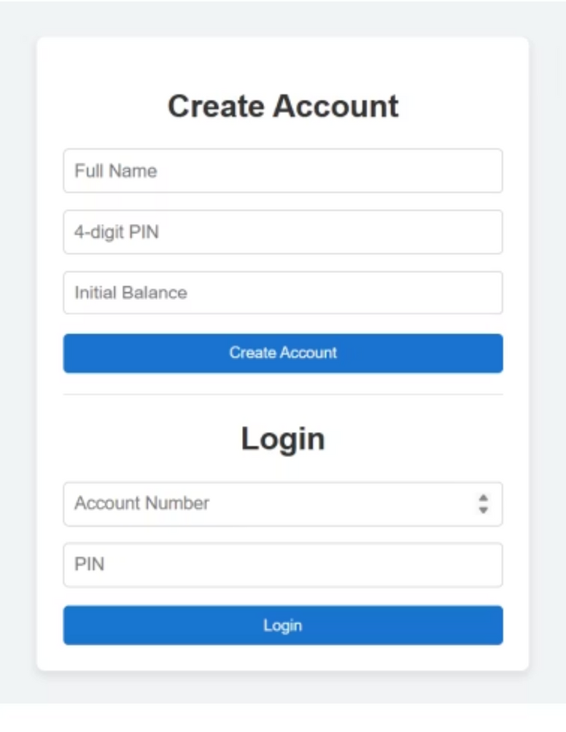
Account Creation
New User Registration
Users provide personal details and set up credentials. The system validates input and creates a new account with an initial balance of zero.
Username and password setup
Input validation
Secure credential storage
Notes:
6

Slide 7

Login & Authentication
Secure Access
Users authenticate using their credentials. The system verifies identity before granting access to the dashboard.
Credential verification
Session management
Error handling for invalid logins
Notes:
7

Slide 8
Dashboard & Transactions
Dashboard View
Deposit Function
Central hub displaying current balance with options for deposit and withdrawal operations
Add funds to account with instant balance updates and confirmation messages
Withdraw Function
Transaction History
Remove funds with built-in validation to prevent insufficient balance errors
Complete log of all account activities with timestamps and amounts
Notes:
8

Slide 9
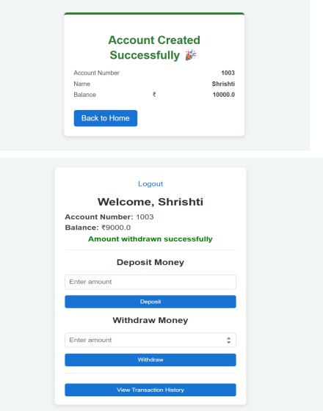

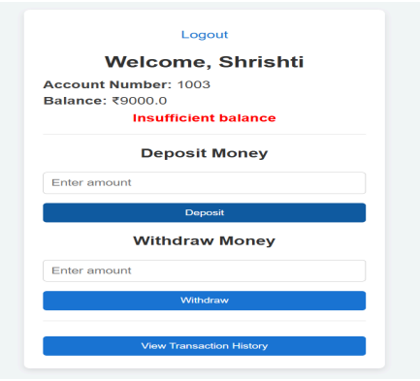
Withdraw Function
Transaction History

Slide 10
Key Highlights
User-Friendly Interface
Clean, intuitive design requiring minimal user training
Secure Login System
Protected authentication preventing unauthorized access
Real-Time Updates
Instant balance reflection after every transaction
Transaction Tracking
Complete history for audit and review purposes
MVC Architecture
Industry-standard design pattern ensuring maintainability
Notes:
10

Slide 11
OOPS Concepts Used
Classes & Objects
Classes represent real-world entities such as bank accounts and transactions. Objects are used to access the properties and methods of these classes.
Encapsulation
Sensitive account details like balance and PIN are protected using access modifiers. Data is accessed securely through controlled methods.
Packages
The project is organized into packages such as controller and test. This helps maintain modularity and a clean project structure.
Abstraction
Only essential operations like deposit and withdrawal are exposed to users. Internal implementation details are hidden from the user.
Exception Handling
Handles conditions such as insufficient balance. Ensures smooth execution and prevents system failure.

Slide 12
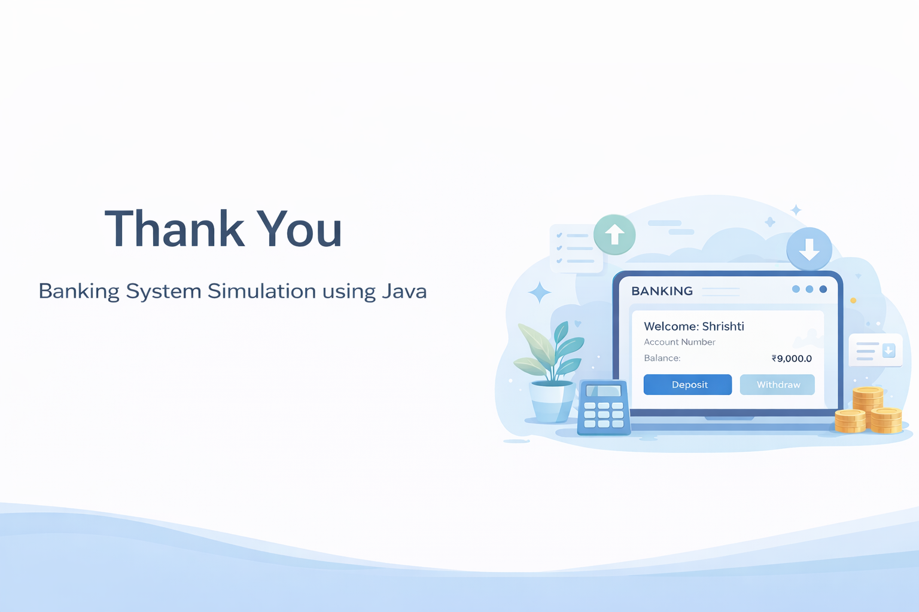
Notes:
11

